Slide 1
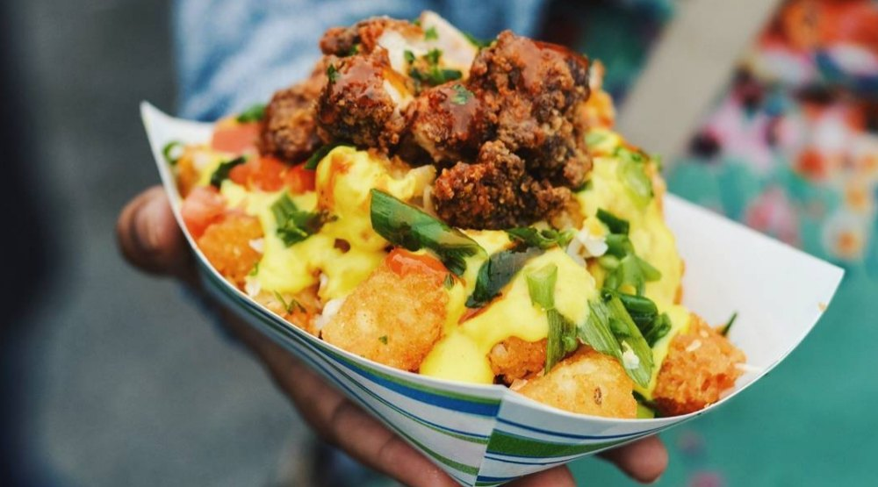

Halal Certificate
A Halal certificate is a guarantee that products comply with the Islamic dietary requirements.
(lines added for requirement check) (symbol)(number)

Slide 2
Importance
In the year 2016-17, Malaysia imported 51038 tons of beef from Australia, a significantly high amount considering the population of the country, which amounted to $401,043,000. This makes Malaysia one of the largest importers of meat from Australia.
Strict import guidelines are imposed on meat and food products

Slide 3
Market Size and Picture
Statistics
(ex. Population of muslims in the UK)
With a global consumer base of about 1.9 billion Muslims across 112 countries, the Halal market size is estimated to be worth of trillions of US Dollars.
With the global halal food trade estimated at A$1.75 trillion annually, Muslim markets provide a lucrative opportunity for Australian companies.

Slide 4
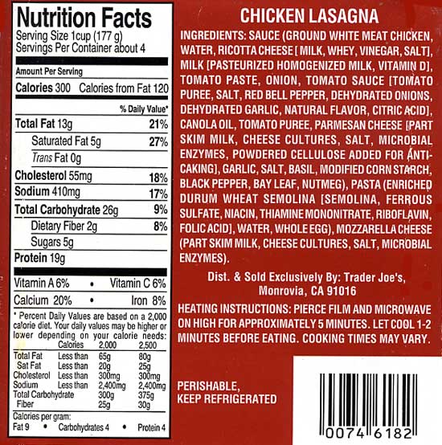
Problems
What’s out there? - (tags & guidance) previous page
Doubtful food such as Beef sausages containing tiny bit of pork; anything with animal fat, Margarine; blood pudding; carnivorous animals
Is it trustworthy? - (various certifier/ auditor) following page
Utensils and equipment; animal stun;
some halal certification providers are associated with, or part of, larger Australian Islamic organisations, such as the Australian Federation of Islamic Councils, others are stand-alone businesses that provide local certification services.

Slide 5
Halal Standard
1. Important definitions as provided for the Trade Description Act (usage of Statement ‘HALAL’) 1975
2. Sources of foods and drinks
3. Slaughtering of animals
4. Alcohol usage
5. Presentation and storage
6. Processing and cooking of food
7. Hygiene
8. Utilized Goods
9. The Label Halal (Permissible)
10. Conclusion

Slide 6
“With so much uncertainty about what constitutes halal, how products are certified and who is doing the certification, consumers who wish to buy halal food can find that a difficult task.”
https://theconversation.com/explainer-what-is-halal-and-how-does-certification-work-36300
“It is a question of labelling. I think there should be more information.
Read more: http://www.dailymail.co.uk/news/article-2622830/Millions-eating-halal-food-without-knowing-How-big-brand-shops-restaurants-sell-ritually-slaughtered-meat-dont-label-it.html#ixzz4uFko9ouf ”

Slide 7
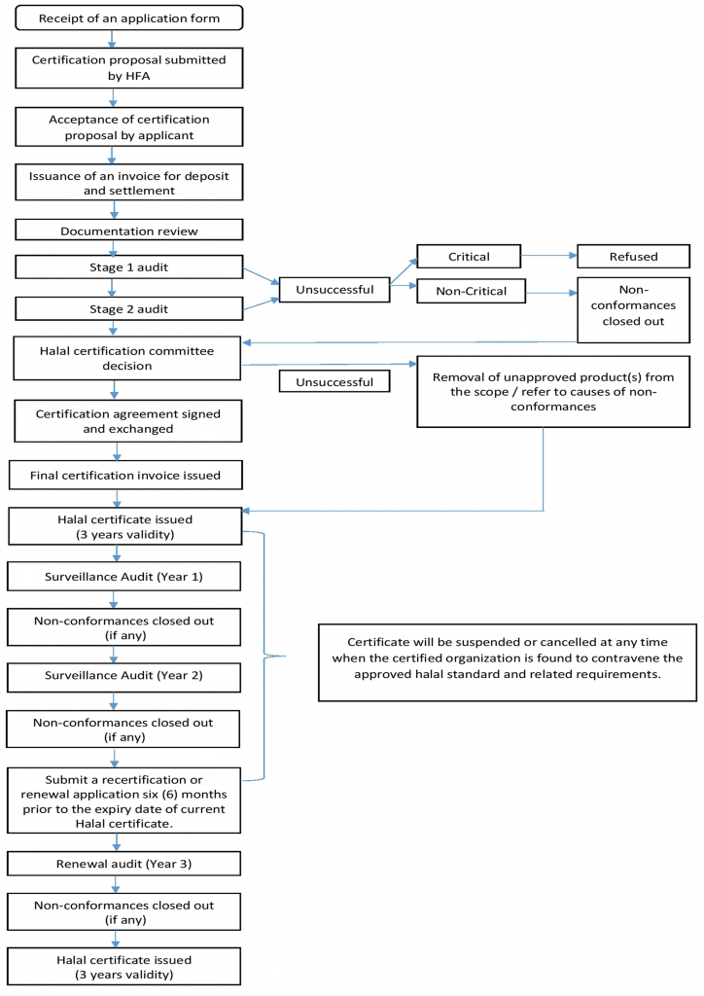
Problem with Current Halal Certification Process
(pictures of pork product)
(pictures of pork and other kind of meat which looks similar) - food is deceitful!
Slaughter house certiticate
Product certificate
Retailors
Origin - (screenshot of pieces of news/ news headings similar to the beef scandal)
Process - (meat oil added to dish)
Facilities - (knife etc..)
retailors
=> Check Manually
=> time-consuming
=> cross-country standard
=> transparency
=> funding for audioring agencies

Slide 8
Blockchain 4 Food
What | How | Effect

Slide 9
Solution visualisation
(mockup)
Ingredients
production process
Production facilities
=> Reliable, efficient Halal verification process

Slide 10
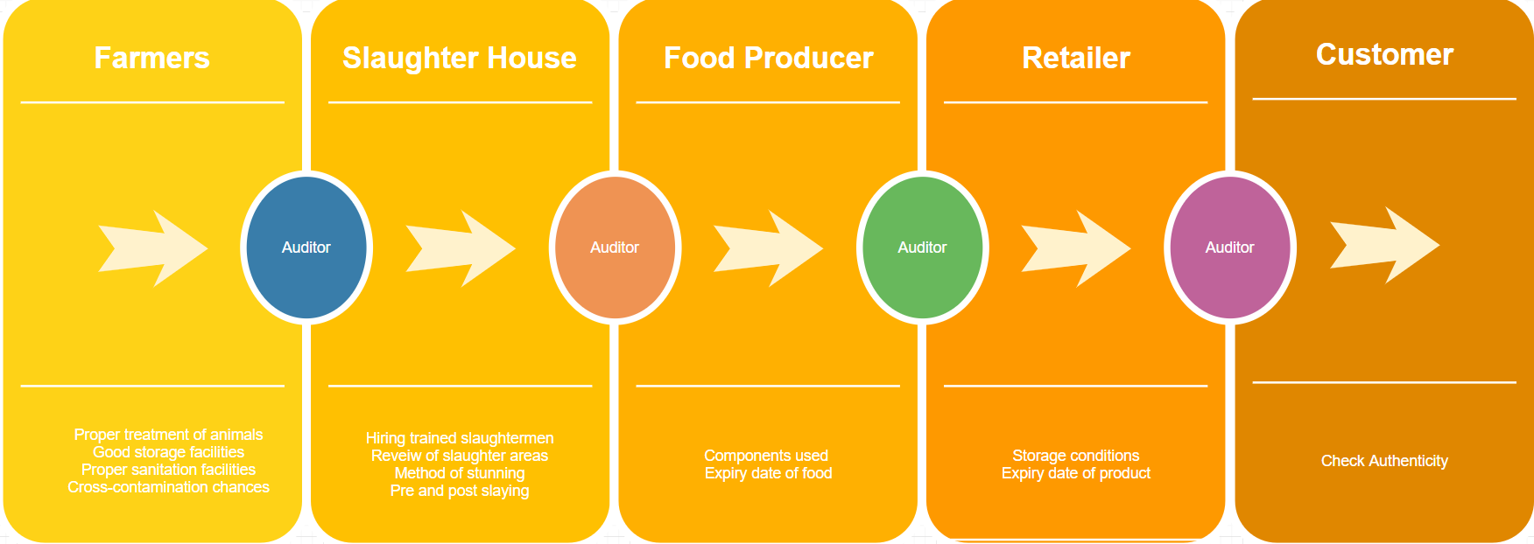
Why we are different
Asset, transaction, participants

Slide 11
Demo
Front-end
Back-end

Slide 12
Outcome
1. TRANSPARENCY IN HALAL CERTIFICATION PROCESS: NO MORE ISSUES ON HOW THE PROCESS IS DONE AND WHETHER THE PROCESS FUNDS THE TERRORIST BECAUSE THE AUDITORS IN EACH STEP ARE LIMITED AND CAN BE CONTROLLED BY THE GOVERNMENT
2. PROVENANCE OF EACH PART OF FOOD PRODUCTS
3. EFFICIENCY: NO NEED TO FILL IN PAPER, NO NEED TO CHECK ALL INGREDIENTS AGAIN AND AGAIN FOR EACH FOOD PRODUCT, AND SHARING OF CERTIFICATE IN AN AUTOMATED WAYS FOR MANY HALAL CERTIFICATION BODIES AROUND THE WORLD
Stakeholders:
Dietary manufactures
Food export / import
Consumers

Slide 13
Externalities 1 - TRADE!
(picture of Irish food exporting to Muslim countries)
Tackle Trade Obstacles - (cross-country standard)
Relieve Social Conflict - (ex. Australia)

Slide 14
Plan in the future
Globalisation
Sustainable supply chain: verification for other type of food for people with other religious background
halal, kosher, vegan, fairtrade, gluten-free or organic, food certification services help consumers to make informed decisions about the food they eat

Slide 15
Team

